Slide 1


Slide 2
Chapter 7
Relational Database Design by ER- and
EER-to-Relational Mapping

Slide 3

FIGURE 7.1
The ER conceptual schema diagram for the COMPANY database.

Slide 4

FIGURE 7.2
Result of mapping the COMPANY ER schema into a relational schema.

Slide 5

FIGURE 7.3
Mapping the n-ary relationship type SUPPLY from Figure 4.11a.

Slide 6
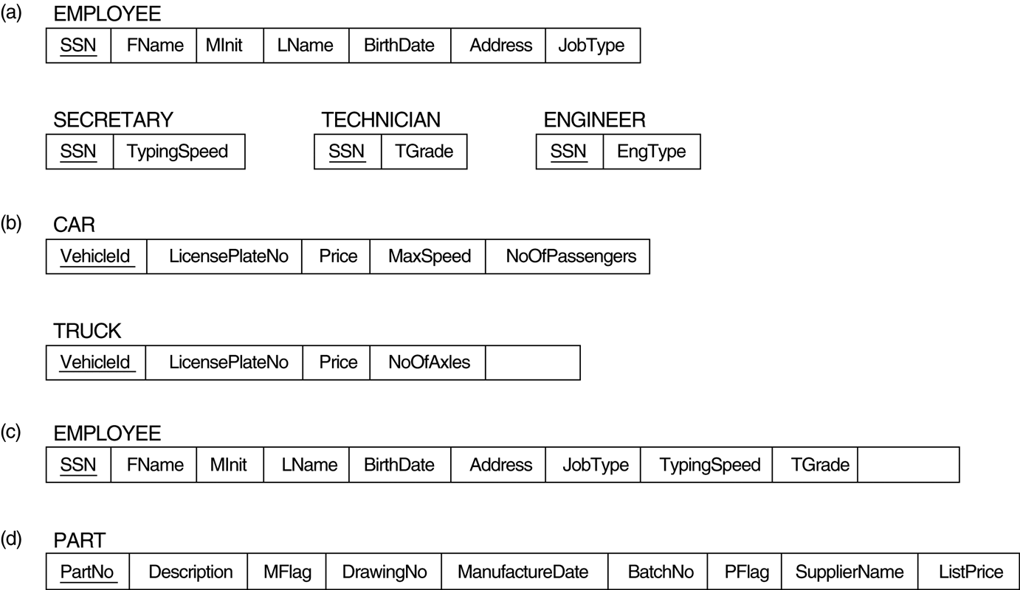
FIGURE 7.4
Options for mapping specialization or generalization.
(a) Mapping the EER schema in Figure 4.4 using option 8A. (b) Mapping the EER schema in Figure 4.3b using option 8B. (c) Mapping the EER schema in Figure 4.4 using option 8C. (d) Mapping Figure 4.5 using option 8D with Boolean type fields Mflag and Pflag.

Slide 7
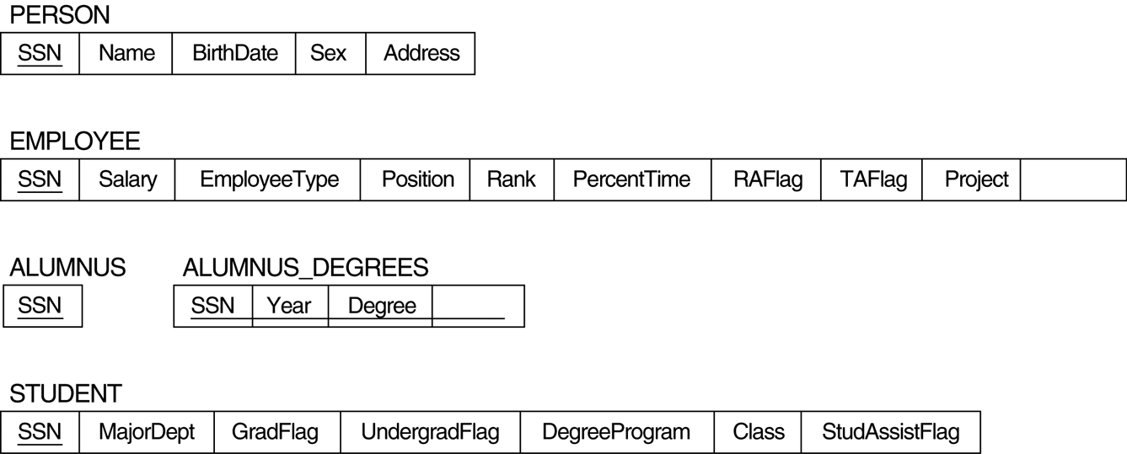
FIGURE 7.5
Mapping the EER specialization lattice in Figure 4.6 using multiple options.

Slide 8
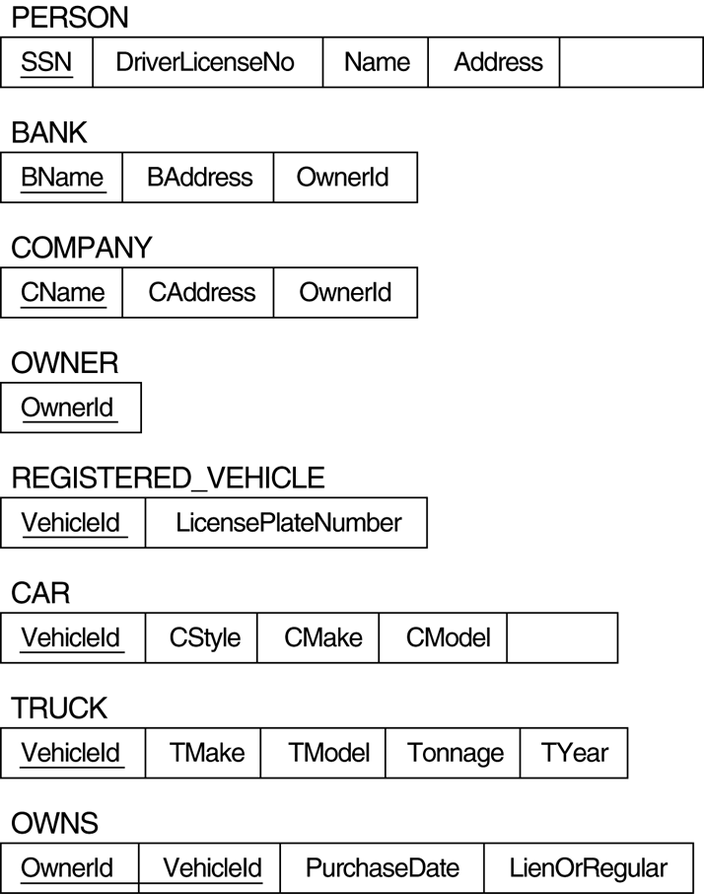
FIGURE 7.6
Mapping the EER categories (union types) in Figure 4.7 to relations.

Slide 9

FIGURE 7.7
An ER schema for a SHIP_TRACKING database.

